Slide 1
TC INT
STATUS OF DIAMETER TEST SPECIFICATION
© ETSI 2015. All rights reserved

Slide 2
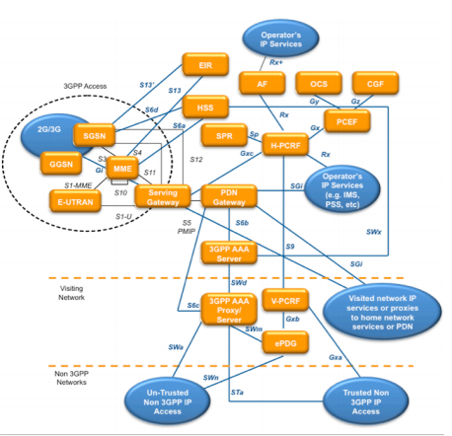
Summary
What has been produced
What has been implemented by the market
What is missing
Potential updated due to 3GPP release update
Priorities connected to the missing interfaces
Priorities for the future development

Slide 3
Status of Diameter Test Specifications: What has been produced
Complete conformance test specifications (PICS, TSS&TP, ATS&PIXIT) for interfaces
Rx TS 101 580-1/-2-3 (STF 434) + validation (STF 450)
Gx TS 101 606-1/-2-3 (STF 443) ​+ validation (STF 450)
S6a TS 103 261-1/-2-3 (STF 466) + validation (STF 482)
S9 TS 103 262-1/-2-3 (STF 466) + validation (STF 482)
Cx/Dx TS 103 289-1/-2-3 (STF 480) + validation started (STF 500) ​
Rf/Ro DTS/INT-00121-1/-2-3 (STF 490) work ongoing until March 2016

Slide 4
What has been implemented by the market?
Tektronix has implemented at least the Rx and Gx tests on their Spectra2 tool (see whitepaper at http://www.tekcomms.com/sites/tekcomms.com/files/Diameter_Network_Whitepaper_CMW-29119-1_0.pdf Potentially other test tool vendors have implemented or are planning to implement the other test specifications.
Deutsche Telekom is using INT test specifications for in house testing.
Partners in validation used the test specifications:
Italtel,
Iskratel,
Sintesio,
Metaswitch,
NG4T,
PT Inovacao,
Tektronix

Slide 5
What is missing and potential updated due to 3GPP release update
Sh/Dh interface test specification + validation
Rf/Ro interface validation
All test specifications follow 3GPP Rel.10 and at the moment no new releases are necessary as there seem no big changes in the Diameter specifications in later 3GPP releases
Priorities connected to the missing interfaces
There is only one interface set left for Diameter: Sh/Dh

Slide 6
Priorities for the future development
Rf/Ro interface validation
Sh/Dh interface test specification
Sh/Dh interface validation

